Slide 1
Computational neuroscience course
Ahmadreza Keihani, PhD
# Pages: Fall, 2023 Ahmadrezakeihani@gmail.com, keihania@upmc.edu

Slide 2
Session 1: Orientation and course setup
Welcome message and course introduction
Course structure and expectations
Getting familiar with the course materials
Setting up the necessary software and tools
# Pages: Fall, 2023 Ahmadrezakeihani@gmail.com, keihania@upmc.edu

Slide 3
Setting up the necessary software and tools
Introduction and overview
Installing Python and PyCharm
Link 1: Installing Python
Link 2 : Installing PyCharm
Link 3: Video for installing both of them together
If you don’t have access to YouTube try this link
# Pages: Fall, 2023 Ahmadrezakeihani@gmail.com, keihania@upmc.edu

Slide 4
What is computational neuroscience ?
Yes, the brain is a computer…
Our honor to have this guest!
No, the brain is not like a computer…
# Pages: Fall, 2023 Ahmadrezakeihani@gmail.com, keihania@upmc.edu

Slide 5
Session 2: Python for the practicing computational neuroscientist
Introduction/statements/terms/materials/dataset/modalities
Programming mindset and flowcharts/algorithm definition
Introduction to Jupyter Notebooks in PyCharm, variables, operators, data types, practice problems, etc.
Files
Sample data (.mat file)
Notebook (01_AK_Changes.ipynb)
Supplementary file (programming mindset)
# Pages: Fall, 2023 Ahmadrezakeihani@gmail.com, keihania@upmc.edu

Slide 6
Session 3: Brain signals analysis in python
Brain bio signals modalities
EEG signals
The event-related potentials
Case Study: an EEG ERP task
Files
Notebook
Data
EEG and other modalities two .ppt files
# Pages: Fall, 2023 Ahmadrezakeihani@gmail.com, keihania@upmc.edu

Slide 7
Session 4: Brain signals analysis in python- Beyond the basics in python with brain’s data: more examples
The event-related potentials
Case Study: an EEG ERP task
More details
More focus on statistical point
Files
Notebook
Data
EEG and other modalities two .ppt files
my_module.py
Attached image (bootstrapERPdiff.png)
# Pages: Fall, 2023 Ahmadrezakeihani@gmail.com, keihania@upmc.edu

Slide 8
Session 5: Brain signals analysis in python- Beyond the basics in python with brain’s data
Power spectrum of brain data
Intuition behind power spectrum
Files
Notebook
Data_File
Images
# Pages: Fall, 2023 Ahmadrezakeihani@gmail.com, keihania@upmc.edu

Slide 9
Session 6: Brain signals analysis in python- Beyond the basics in python with brain’s data
Complete the session!
Power spectrum of brain data
Intuition behind power spectrum
Files
Notebook
Data_File
Images
A short introduction for next sessions!
# Pages: Fall, 2023 Ahmadrezakeihani@gmail.com, keihania@upmc.edu

Slide 10
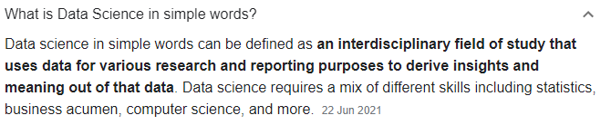
Data Science

Slide 11
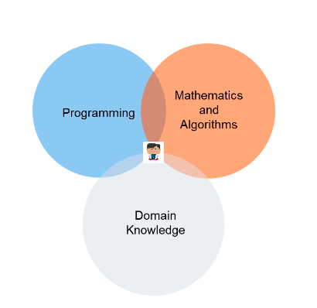
Data Science
https://www.datarobot.com/wiki/data-science

Slide 12
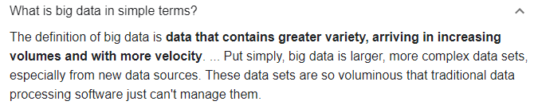
Big Data

Slide 13
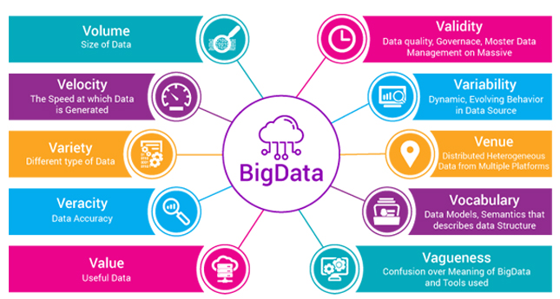
Big Data
https://towardsdatascience.com/big-data-analysis-spark-and-hadoop-a11ba591c057

Slide 14
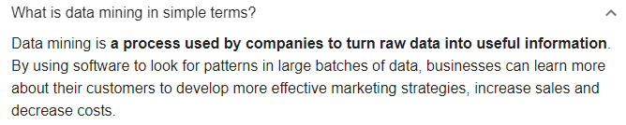
Data Mining

Slide 15
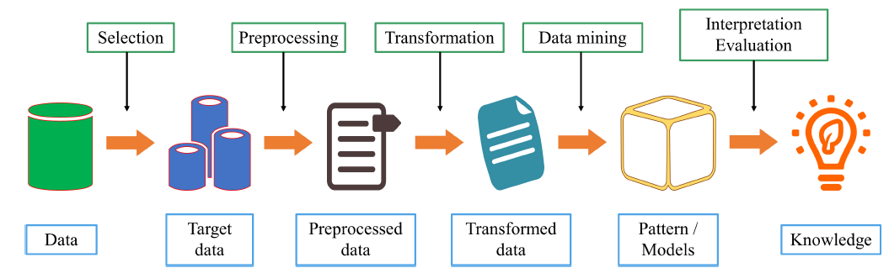
Data Mining
General steps in data mining process.
Yang, Aimin, et al. "Review on the Application of Machine Learning Algorithms in the Sequence Data Mining of DNA." Frontiers in Bioengineering and Biotechnology 8 (2020): 1032.

Slide 16
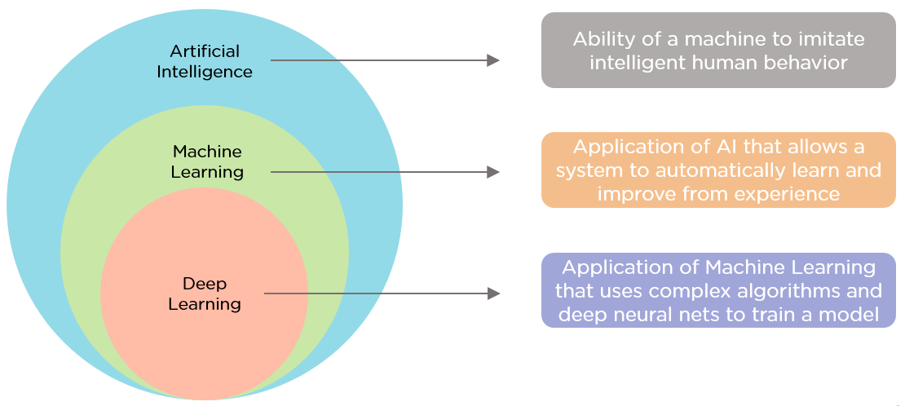
Artificial Intelligence
Artificial intelligence (AI)
Machine learning (ML)
Deep learning (DL)

Slide 17
AI, ML, DL
Artificial intelligence (AI)
AI is defined as “the theory and development of computer systems able to perform tasks normally requiring human intelligence, such as visual perception, speech recognition, decision-making, and translation between languages”.
Machine learning (ML)
ML is the subset of AI that allows systems to learn from data and develop self-learning algorithms. ML applications can learn from data without being explicitly programmed; make predictions and recommendations using various tools; and enable computer applications to improve their performance.
Deep learning (DL)
DL is a subfield within ML that allows machines to use algorithms inspired by the structure of neural networks. A computer can learn how to classify images and how to assign labels to words in a sentence (semantic labeling) by using DL algorithms.
Sapci, A. Hasan, and H. Aylin Sapci. "Artificial intelligence education and tools for medical and health informatics students: systematic review." JMIR Medical Education 6.1 (2020): e19285.

Slide 18
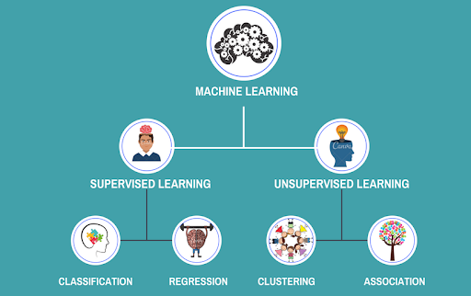
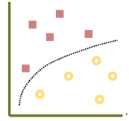
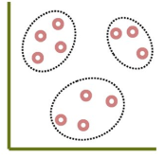
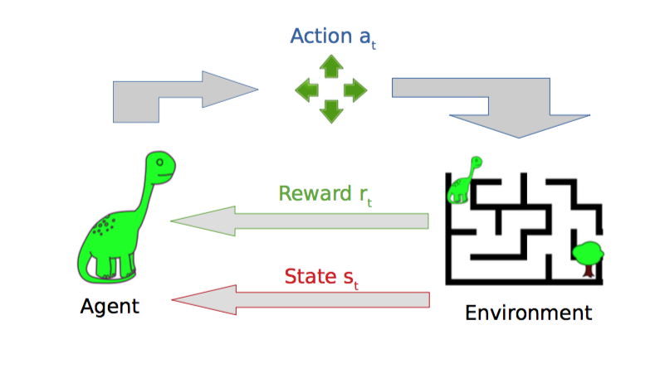
Machine Learning
Supervised
Unsupervised
Reinforcement

Slide 19
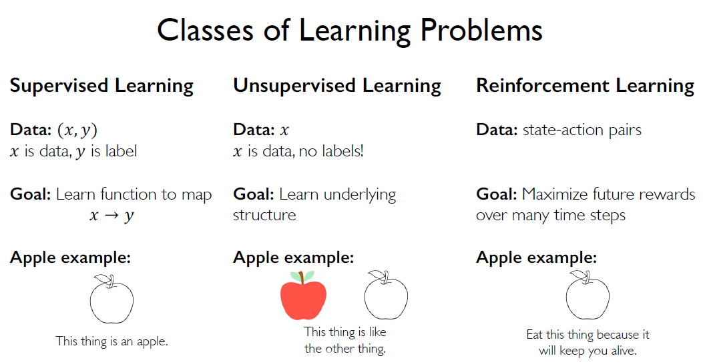
Machine Learning

Slide 20

Machine Learning
Preview - Supervised

Slide 21

Machine Learning
Preview – Unsupervised (ICA-1)
Mixed
Separated

Slide 22
Machine Learning
Preview – Unsupervised (ICA-2)
Mixed
Separated

Slide 23
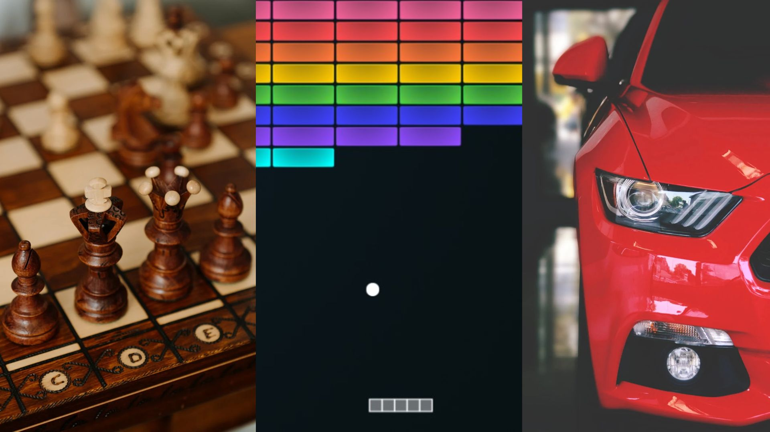
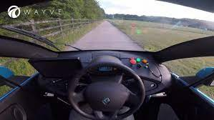
Machine Learning
Preview – Reinforcement Learning
https://venturebeat.com/2021/09/04 /demystifying-deep-reinforcement-learning/

Slide 24
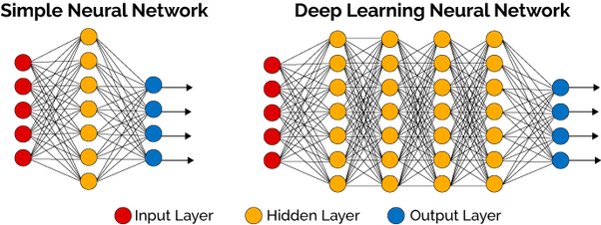
Deep Learning
https://www.quora.com/What-is-Nvidia-DLSS-Deep-Learning-Super-sampling-and-how-exactly-does-it-work

Slide 25
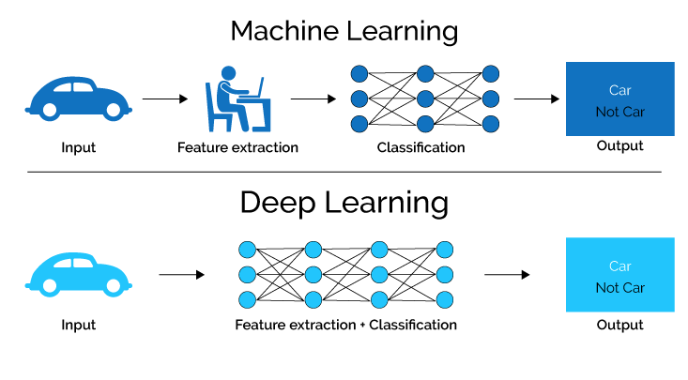
Deep Learning
https://ccm.net/contents/1278-what-is-artificial-intelligence

Slide 26
More matreial
C229 --- Stanford machine learning course 2018
C229a---Stanford machine learning course 2019
You can see the relevant links of theses courses here:
https://online.stanford.edu/courses/cs229-machine-learning
http://cs229.stanford.edu/
Search “Andrew Ng”
MIT 6.S191
http://introtodeeplearning.com/
https://www.mit.edu/~amini/teaching.html
Search “Alexander Amini” and “Ava Soleimani”

Slide 27
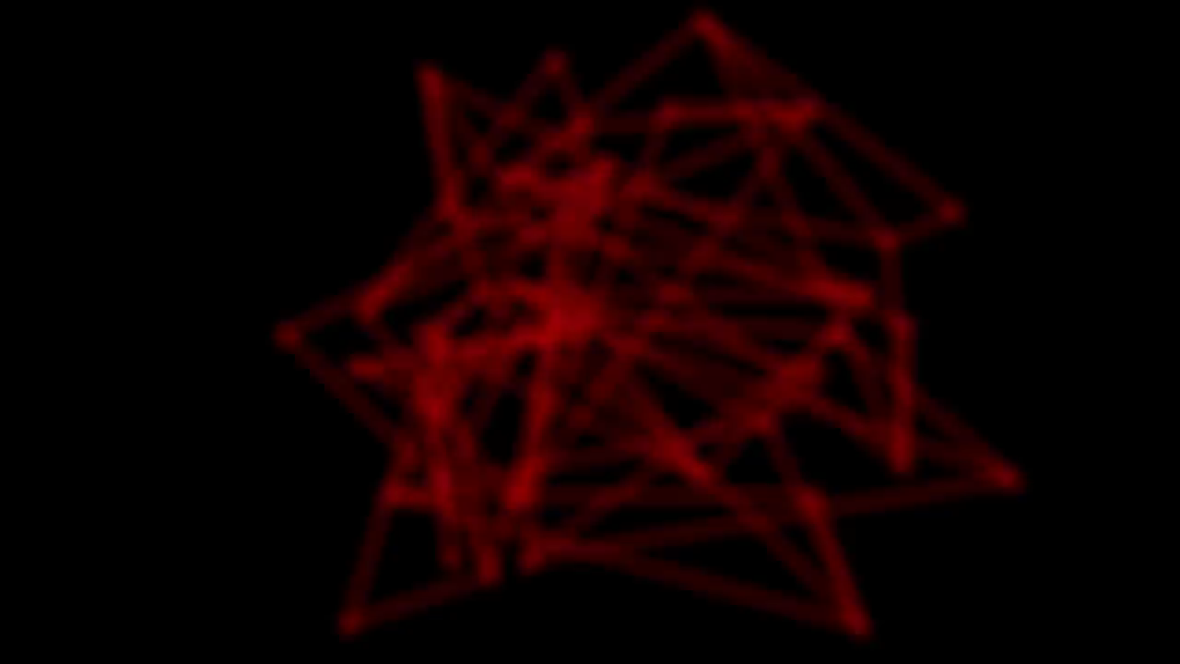
If You Are Interested in Deep Learning

Slide 28
Q & A

